Slide 1
Capstone 2
Arturo Mares

Slide 2
Introduction
Investigate the factors that drive home prices
Understand how it should allocate dollars earmarked for investment into mortgage-backed securities

Slide 3
Hypotheses
Lot configuration: whether homes located in a certain location have a higher value
House style: whether certain homes styles have a higher value
Newness of home: how recently a house was built or renovated increases its value

Slide 4
Data
Dataset is from home sales in Ames, IA between January 2006 – July 2010
The sales price is pulled and compared to the following factors
Lot configuration: cul-de-sac lot vs other lots
Home style: multi-level homes vs single story homes
Newness of home: new homes or homes renovated in the last 5 years vs older homes
T-test conducted to see the probably of the hypotheses of being true or not

Slide 5
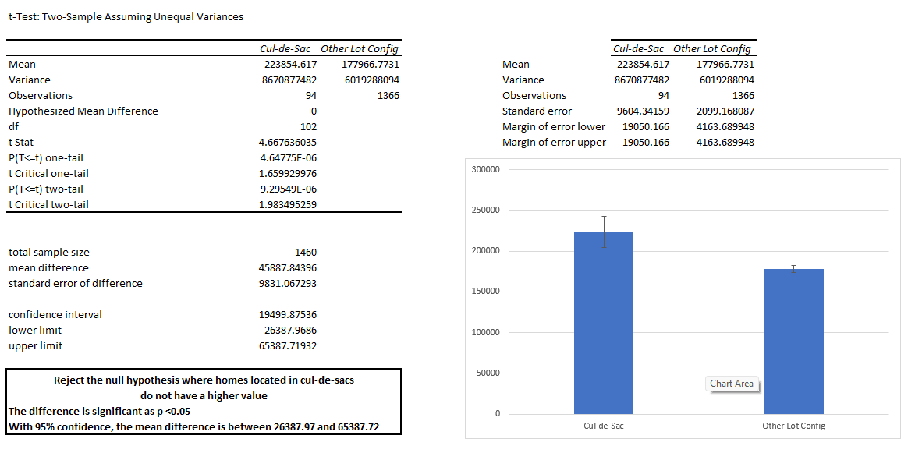
Methods: Lot Configuration Null: Homes on cul-de-sacs do not sell at a higher value Alternate: Homes on cul-de-sacs sell at a higher value

Slide 6
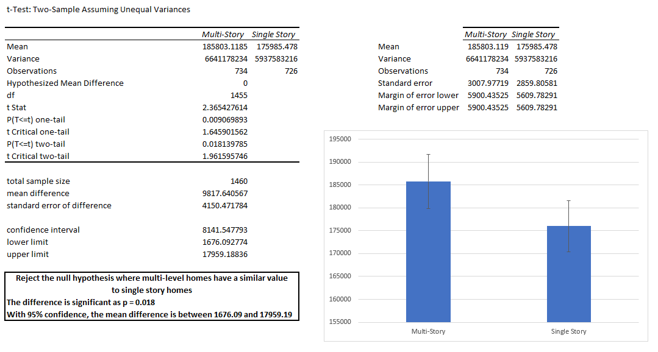
Methods: Home Style Null: Multi-level homes have a similar value to single story homes Alternate: Multi-level homes have a higher value than single story homes

Slide 7
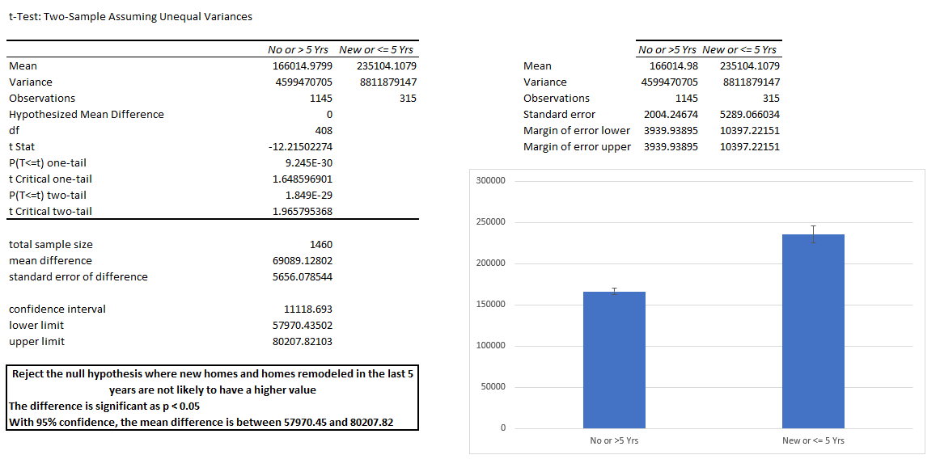
Methods: Newness of Home Null: New homes and homes remodeled in the last 5 years do not have a higher value Alternate: New homes and homes remodeled in the last 5 years have a higher value

Slide 8
Results
Lot Configuration: Homes located in cul-de-sacs have a higher sales value than other homes
Home Style: Multi-story homes have a higher sales value than single story homes
Newness of Home: New homes and homes remodeled in the last 5 years have a higher sales value

Slide 9
Recommendations
Factors to look for in determining homes for mortgage-backed securities
Locale of frontage of home
Whether the home is a multi-story or not
Whether the home was recently built or remodeled

